Slide 1
Hack-IoT 2019 Image Computation and Recognition
3/24/2019
Group 10: Spencer McDonough, Ayush Garg, Valerie Gomez

Slide 2
Big Data for Sustainable Development
The United Nations classifies Traffic Control as a Global Issue.
Data from GPS devices can be used for traffic control,
For making public transport better,
For avoiding collisions,
For Insurance claims,
For use as evidence for crashes/accidents.

Slide 3
I3 Marketplace
There are many barriers preventing the adoption of the Internet of Things (IoT) in smart communities and smart cities, including interoperability, concerns about vendor lock-in, economic constraints, and privacy issues.
Applications and data brokers access and provide value-added services to these IOT-based communities.
Allows client to send image for processing to a much more powerful computer and receives the processed image through the Marketplace.

Slide 4
Approach

Slide 5
Vision
Customer owns dashcam and wants data processed: they purchase an image processing product on the i3 marketplace
An event (an accident or hard breaking) occurs and triggers the camera to publish an image of the car in front and/or behind
The image is processed by the server and sends back information such as plate number vehicle type, speed, gps location, etc.
Can also send data to customer’s insurance company and automatically make claim
Can send data to police department
Can also sell dashcam data to other 3rd parties

Slide 6
approach
Grab image from rPi
Publish image to a i3 marketplace using mqtt publish method
Server subscribed to client topic, pulls image and processes
License plate is isolated and characters are identified
License plate image is saved and sent back to the customer

Slide 7
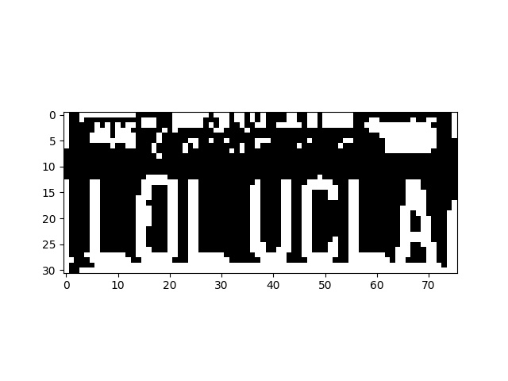
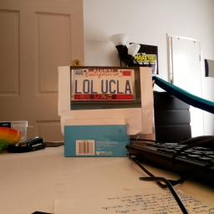
Raw and Processed Image

